Slide 1
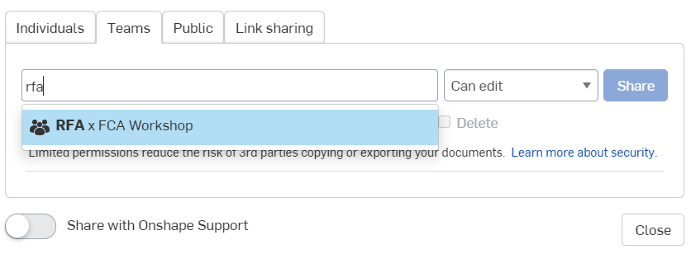
Share your documents!
Notes:
Maya

Slide 2
Resources

Slide 3
Training from FCA
Resources from this summer camp (recordings & presentations): https://drive.google.com/drive/folders/1Iq_i740o0zmNAm7QY0gXvBOCaqlYY-BQ?usp=sharing
Misc. Design Team Training: https://drive.google.com/drive/folders/1xhFPnjahYh_Ihwr8o7WN2WfkdMUpvRW2?usp=sharing
Misc. Electrical Team Training: https://drive.google.com/drive/folders/1synU1HZl5xBiAtOtU78HX4MG1FxLIitB?usp=sharing
Notes:
Alex

Slide 4
Learning Resources
Jeff! https://www.youtube.com/channel/UCXKW_dKcpFh358S1rV5qBDw
Compilation of everything relating to physics: https://docs.google.com/document/d/14oCnP8T2-k6qIM0NTdhdtQUyo2WPDx2JQD-v9W4yvdg/edit
Phet Lab: https://phet.colorado.edu/
EAA: http://www.eaa20.org/
Notes:
Maya

Slide 5
Software
Fusion (and everything else from Autodesk): https://www.autodesk.com/education/edu-software/overview?sorting=featured&page=1
Solidworks: https://www.solidworks.com/product/students
Ansys: https://www.ansys.com/academic/students
XFLR5: https://sourceforge.net/projects/xflr5/files/
You will need this: https://docs.google.com/presentation/d/1AWKCgZYjvwBCSnMBxV08a9sHDyFfkl-l3eytjMdUTPg/edit
Notes:
Alex

Slide 6
Please Donate!
flightclubaerospace.com/supportus/
Notes:
Maya

Slide 7
Future Steps
Notes:
Alex

Slide 8
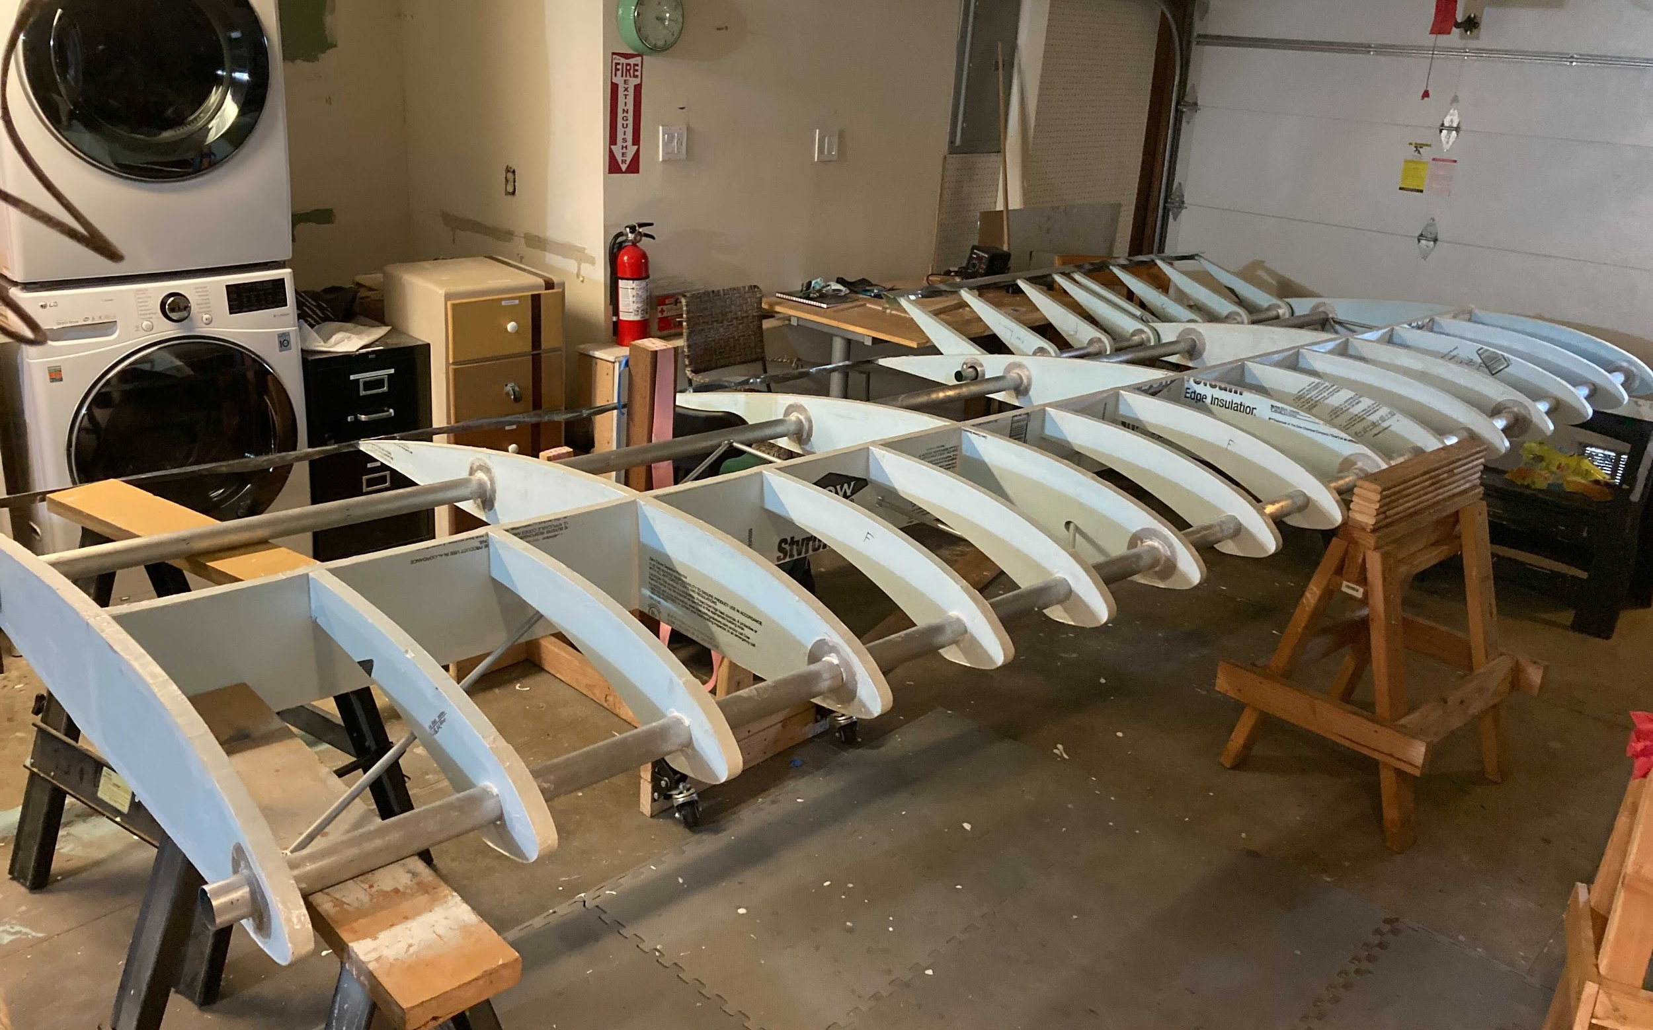
Join our team!
Interest form: https://docs.google.com/forms/d/1aMQnUPUBMCTIusxU8U20h7HNG00A6MugwTei7TxZ2pc/edit
Notes:
Alex
Note that you don’t have to know a lot, just be willing to work. And be a high schooler ofc

Slide 9
Teams & Skills
Design
Physics
Electrical
CAD (Fusion)
Research
Computational fluid dynamic simulations (AutoCAD)
Static stress simulations (Fusion)
Custom PCB design (Eagle)
Finance
Communications
Software
Graphic design (Adobe Illustrator)
Website management & design (Wordpress)
Grant research + writing
Budget management
Communication with Hack+
Avionics & sensor design
User interface (Javascript)
Notes:
Maya

Slide 10
Thank you!
Notes:
Alex + Maya

